Slide 1
AI Construction Costs Can Be an Accounting ‘Black Box’
Week 5
Ed Elowson
https://www.wsj.com/articles/ai-construction-costs-can-be-an-accounting-black-box-3c197b09?utm_source=chatgpt.com

Slide 2
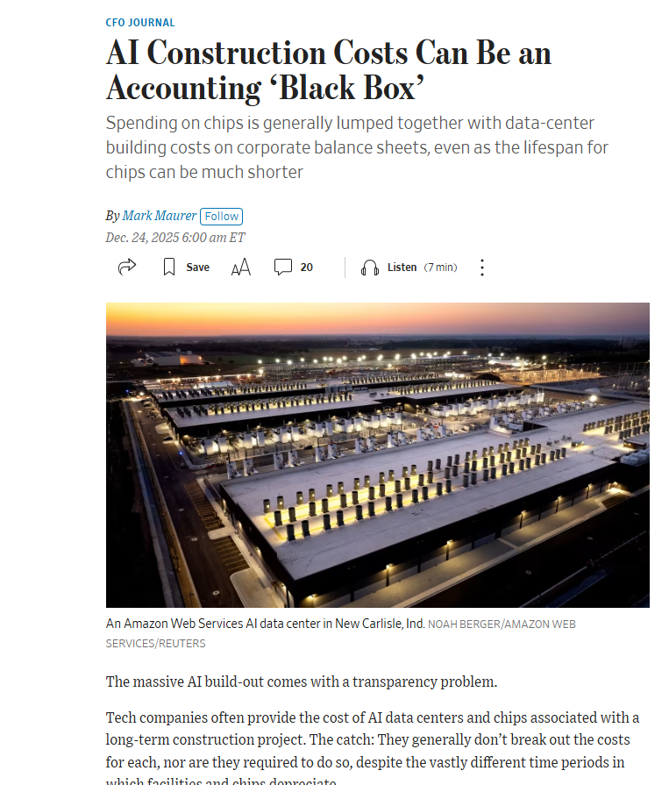

Slide 3
Main Findings and Arguments
1. Main Findings and Arguments
1. Lack of transparency in AI infrastructure spending
Tech companies are investing hundreds of billions of dollars in AI infrastructure, including data centers, chips, and networking equipment.
However, financial disclosures often bundle together the costs of buildings and AI chips in accounting categories like “construction in progress.”
This creates limited transparency for investors trying to understand where the money is actually going.
2. Major mismatch in asset lifespans
Data-center buildings may last 20–40 years.
AI chips (such as GPUs) can become obsolete in less than three years.
When these costs are grouped together, it becomes difficult to assess the true long-term value and depreciation of AI investments.
3. Investors are pushing for better reporting
Analysts and shareholders want companies to separate spending on physical infrastructure from computing hardware.
Without this breakdown, investors struggle to estimate risk and future profitability.
4. Construction spending for AI is exploding
Spending on data center construction is expected to surpass office-building construction soon.
Companies such as Alphabet, Amazon, Meta Platforms, and Microsoft have tens of billions of dollars tied up in assets still under construction.
5. Accounting rules currently allow limited disclosure
U.S. accounting standards do not require companies to break out AI chip costs separately.
The standard-setting body Financial Accounting Standards Board currently has no active project requiring such disclosures.

Slide 4
Broader Implications for Society
2. Broader Implications for Society
1. Massive global investment in AI infrastructure
The rapid expansion of AI is driving one of the largest infrastructure build-outs in modern technology history, centered on data centers and advanced computing hardware.
2. Economic uncertainty around AI returns
Investors are concerned about whether massive AI investments will produce enough economic value to justify their cost.
Rapid technological obsolescence means companies may need to continuously replace expensive chips, increasing financial risk.
3. Transparency and governance challenges
Limited disclosure creates information asymmetry between tech companies and investors.
Policymakers and accounting regulators may eventually face pressure to improve reporting standards.
4. Growing dependence on AI infrastructure
As society increasingly relies on AI systems for services, communication, and productivity, data centers and compute resources become critical infrastructure similar to power grids or transportation networks.

Slide 5
Relevance or Potential Influence on the Construction Industry
3. Relevance or Potential Influence on the Construction Industry
1. Data centers are becoming a major construction sector
AI development is driving massive demand for new data centers, potentially surpassing traditional commercial construction sectors like office buildings.
2. New types of highly specialized buildings
AI data centers require advanced:
cooling systems
power infrastructure
network connectivity
large physical footprints
This is creating specialized construction expertise and new project opportunities.
3. Construction project risks may increase
Data center projects face potential delays due to:
power supply limitations
local political approval processes
supply-chain constraints.
4. Faster technology cycles affect construction planning
Because computing hardware becomes obsolete quickly, facilities may require frequent retrofits or upgrades, influencing building design and lifecycle planning.
5. Construction demand tied to AI growth
The continued expansion of companies like Amazon Web Services, Microsoft, and Alphabet will likely sustain long-term demand for large-scale data center construction.

